Slide 1
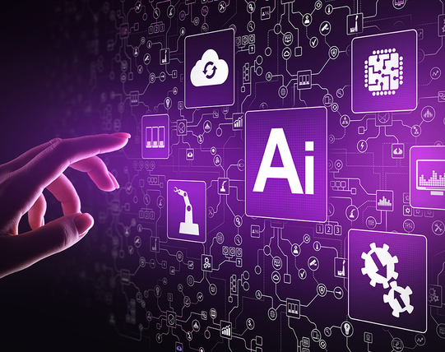


UiPath AI Center
By Nisarg Kadam
UiPath MVP | Senior Consultant WonderBotz
7th June 2021

Slide 2

UiPath Fully Automated Enterprise
Discover
Automation Hub
Task Capture
Build
Studio
StudioX
Manage
Orchestrator
Test Suite
Run
Engage
Process Mining
Task Mining
Document Understanding
Automation Ops
AI Center
Data Services
Insights
Marketplace
Robot
Attended Robots
Apps
Assistant
Action Center
Chatbots
UiPath AI Center

Slide 3
AI Center: AI+RPA
RPA doesn’t learn on its own. It needs AI for its robots to learn new skills.
Collects data from any disparate source and processes it, but can only automate simple tasks
RPA
AI
Finds patterns and insights to make complex decisions, but needs processed data from disparate sources
The potential of RPA is vast, and when paired with AI it is almost limitless.
Scale the impact of your automations with AI-enhanced robots.

Slide 4








AI Center: Functionality
Deploy on AI Fabric
Choose a model
Drag & drop into a workflow
CONSUME
AI Fabric
MANAGE
Decision Point
Automate more with robots learning AI skills
DEPLOY
IMPROVE
Improve your models based on human validated data
Human-in-the-loop validation of exceptions

Slide 5











AI Center: AI Capability
Automation of business processes that include
Uncertainty
High Variability
Unstructured Data
You cannot determine an outcome with 100% certainty.
There is too much variability for rules based.
Information like articles, documents, images, videos and emails is unstructured.
Property Valuation
Loan Defaults
Inventory Forecasts
Resume Matching
Purchase Decisions
Language Translation
Invoice Extraction
Email Routing
Speech to Text

Slide 6
AI Center: What is AI Skill
Robot learns a new skill when you deploy an ML model in AI Fabric.
AI skill
Deployed
ML model
=

Slide 7




AI Center: Steps
DEPLOY
CONSUME
MANAGE
IMPROVE

Slide 8




AI Center: Deploy
Easy-to-use interface and secure environment
How do I
DEPLOY
an ML model?
Easily upload ML packages
and deploy AI skills
Model of your choice: ​
Your own models
Out-of-the-box models from UiPath
Pre-built & custom models from UiPath partners

Slide 9





AI Center: Consume
Easily discover AI skills from Activities in Studio
How do I
CONSUME
an ML model?
Drag and drop your models into an RPA workflow
Select an AI skill from a drop down as you build your workflow
Scale AI skills to thousands of Robots with the click of a button​

Slide 10





AI Center: Manage
End-to-end visibility across your teams – RPA developers, data scientists, executives
How do I
MANAGE
an ML model?
Version control and ability to revert to a previous version
Monitor ML model consumption
​Satisfy governance and compliance requirements​

Slide 11




AI Center: Improve
Human-in-the-loop handles exceptions, validates data and routes them for model retraining
How do I
IMPROVE
an ML model?
Constantly improve your models
Produce more accurate results

Slide 12
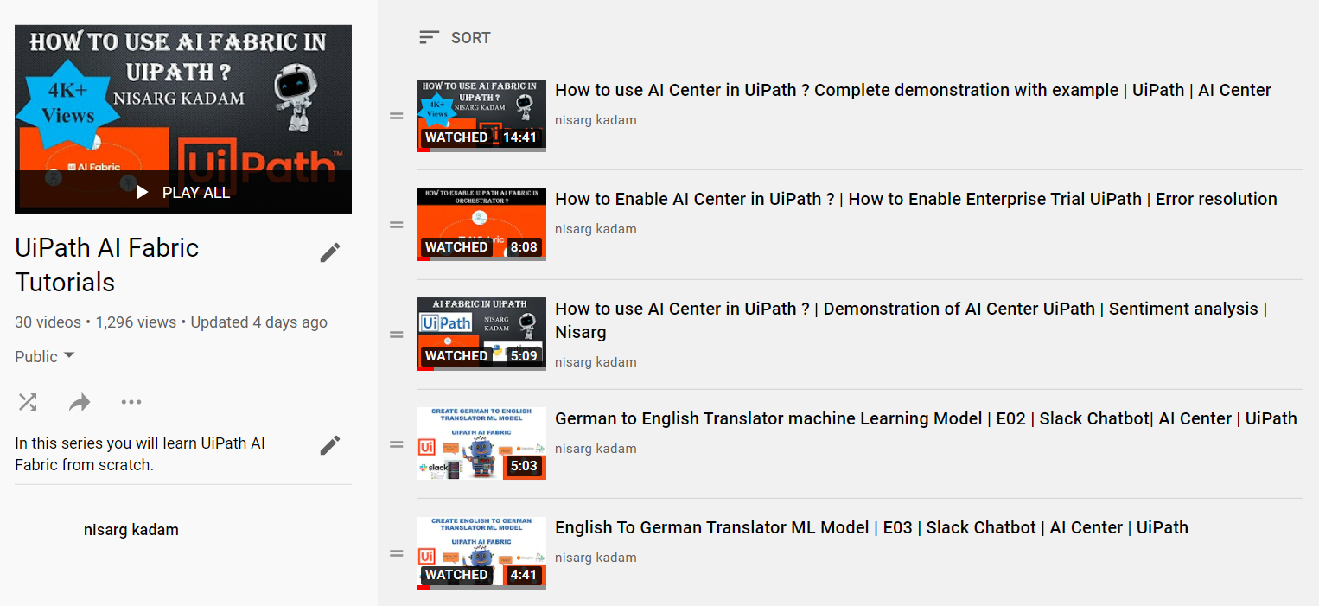
YouTube: AI Center Series
https://www.youtube.com/c/nisargkadam

Slide 13
YouTube: AI Center Series
Service Now Automation
How to enable AI Center?
How to use AI Center?
Invoice document extractor using ML?
Slack Channel Chatbot
QNA Machine Learning
Customer Feedback Automation
Brain stroke prediction
Counting people in supermarket
How to upload custom ML model
Restaurant feedback automation
German tour guider
Object Detection
Profit prediction using TPOT
Identifying sentiments from airline review
Diabetes prediction using ML

Slide 14
Questions?

Slide 15
Thank You!

